Slide 1

BUG TRACKING SYSTEM
Presented By:
M. Bindhu(46282529)
B.Sai sireesha (46287919)
Siraparapu rupika sri (46282334)
Anusha chalapureddi (46282332)
Talabattula Sai Santhosini Reethika
(46282334)

Slide 2
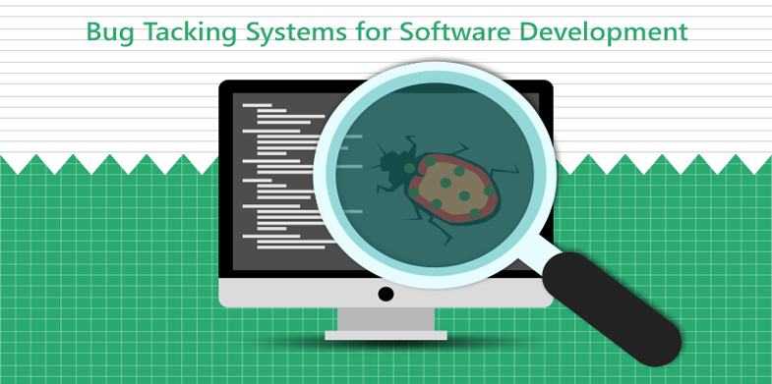
Contents:
Abstract
Introduction
Requirements
Problem statement
Functional Specification
Technical Specification
E-R Diagram
Modules
User Module
Project Management Module
Ticket Management Module
Report Management Module
Data validation Module
Functional Requirements
Tools Used
Conclusion

Slide 3
ABSTRACT:
For many years Bug Tracking mechanism is employed only in some of the large development houses. Most of the others never bothered with bug tracking at all and instead simply relied on shared lists and email to monitor the status of defects.
Bug Tracking System can be used for logging defects against an application/module ,assigning defects to individuals and tracking the defects to resolution.
Nowadays, when project are so extensive defects or bugs have been existed as a problem in the system and they are normally inevitable in software development. A bug could be in either a program’s source code or it’s design.

Slide 4
INTRODUCTION
Bug Tracking System is a web-based application that is designed to help quality assurance and programmers keep track of reported software bugs in their work. It may be regarded as a sort of issue tracking system.
Bugs will be assigned to a person with a bug ID, Project ID.
Bug Tracking System is to test the application for the bugs and report it to the project manager and developer.
The main intention behind the Bug Tracking System is that to track bugs and report them.

Slide 5
REQUIREMENTS
Problem Statement
Functional Specifications
Technical Specifications

Slide 6
PROBLEM STATEMENT
● A bug tracking system is a software application that is designed to help quality assurance and programmers keep track of reported software bugs in their work.
● The purpose of the Bug Tracking System is to test the application for the bugs and report it to the project manager and developer.

Slide 7
FUNCTIONAL SPECIFICATION
Bug tracking system is the perfect or unique solution to track the bugs of a solution, product or an application.
No GUI as it is a console .
Employee details are required for login.
Project Details are required for managing projects
Ticket Details are required for managing tickets.

Slide 8
TECHNICAL SPECIFICATION
Main Menu:
a)Login
b)Register
Bug track menu:
a)Manage Projects:
Only projects created by login employee can be modified.
Only projects which do not have any tickets raised can be deleted
b)Manage Tickets:
Information about tickets is stored in “tickets.txt” file where one line corresponds to one bug
c)Manage Reports:
Generate report as per priority of project or projects assigned by logged-in employee.

Slide 9
E-R Diagram:

Slide 10
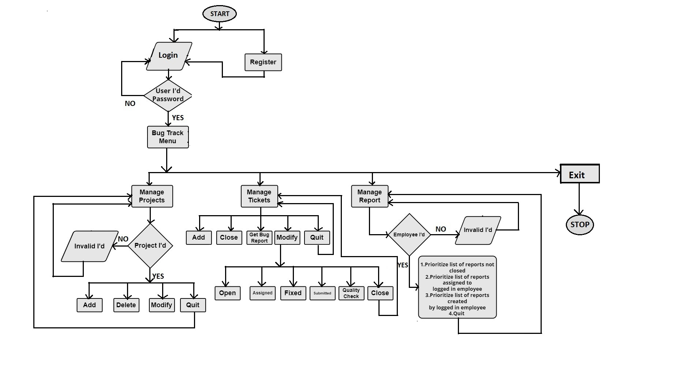
FLOW CHART

Slide 11
MODULES
User login/register
Project management Module
Ticket management Module
Report management Module
Data validation Module

Slide 12
User Module:
In User module, users/employees can register if they are a new users and then login to the system.
Users has the entire access to all other modules.
Project Management Module:
In project management module, Only projects created by login employee can be modified.
Only projects which do not have any tickets raised can be deleted.
Ticket Management Module:
In Ticket Management Module, the ticket gets added, closed and modify.
The employee record the each bug report.

Slide 13
Report Management Module:
In report management module,prioritize the list of reports not closed,prioritize list of reports assigned to logged in employee,prioritize list of reports created by logged in employee and quit.
Generate report as per priority of project or projects assigned by logged-in employee.
Data Validation module:
Data validation is the process of verifying and validating data that is collected before it is used.
Data validation is done for user id,user name,password,ticket id,bug id and project id.

Slide 14
Functional requirements
User:
int login(void);
void registration();
void bug_menu();
Project management
void addproject(void);
void deleteproject(void);
void deleteNode()
void modifyproject(void)
void updateNode();

Slide 15
Functional Requirement
Ticket Management
addticket(void);
displayticket(void);
closeticket(void);
filebug(int);
changestatus();
report();
Report management
void openReports();
void assigned(int eid);
void created();

Slide 16
TOOLS USED
GCC
Make file
Vim editor

Slide 17
CONCLUSION
Bug Tracking System helps to detect and manage the bugs in software products effectively.
Bug Tracking System can be used to track the bugs in the project modules and assist in troubleshooting errors for testing and for development processes.
It highly avoids all sources of delay in bugs reporting level within the project modules in the software industry. As application is deployed in a company server,it is much more secure.

Slide 18



